Slide 1
IBM Data Science Capstone Project
Space X Falcon 9 Landing Analysis
Kunal Chavan

Slide 2
OUTCOME
Executive Summary
Introduction
Methodology
Results
Conclusions
Appendix

Slide 3
EXECUTIVE SUMMARY
Summary of Methodologies:
This project follows these steps:
Data Collection
Data Wrangling
Exploratory Data Analysis
Interactive Visual Analytics
Predictive Analysis (Classification)
Summary of Results:
This project produced the following outputs and visualizations:
Exploratory Data Analysis (EDA) results
Geospatial analytics
Interactive dashboard
Predictive analysis of classification models

Slide 4
INTRODUCTION
SpaceX launches Falcon 9 rockets at a cost of around $62m. This is considerably cheaper than other providers (which usually cost upwards of $165m).
Much of the savings are because SpaceX can land, and then re-use the first stage of the rocket.
If we can make predictions on whether the first stage will land, we can determine the cost of a launch, and use this information to assess whether or not.
This project will ultimately predict if the Space X Falcon 9 first stage will land successfully.

Slide 5
METHODOLOGY
Data collection methodology:
Combined data from SpaceX public API and SpaceX Wikipedia page
Perform data wrangling
Classifying true landings as successful and unsuccessful otherwise
Perform exploratory data analysis (EDA) using visualization and SQL
Perform interactive visual analytics using Folium and Plotly Dash
Perform predictive analysis using classification models
Tuned models using GridSearchCV

Slide 6
Methodology
OVERVIEW OF DATA COLLECTION, WRANGLING, VISUALIZATION,
DASHBOARD, AND MODEL METHODS

Slide 7
DATA COLLECTION OVERVIEW
Data collection process involved a combination of API requests from Space X public API and web scraping data from a table in Space X’s Wikipedia entry.
The next slide will show the flowchart of data collection from API and the one after will show the flowchart of data collection from webscraping.
Space X API Data Columns:
FlightNumber, Date, BoosterVersion, PayloadMass, Orbit, LaunchSite, Outcome, Flights, GridFins,
Reused, Legs, LandingPad, Block, ReusedCount, Serial, Longitude, Latitude
Wikipedia Webscrape Data Columns:
Flight No., Launch site, Payload, PayloadMass, Orbit, Customer, Launch outcome, Version Booster, Booster landing, Date, Time

Slide 8

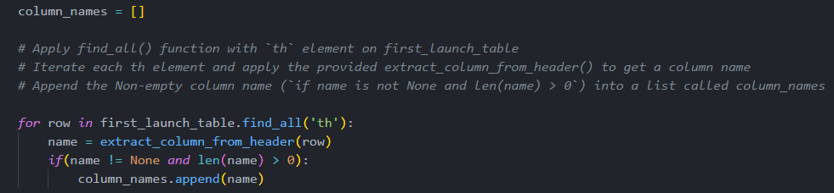
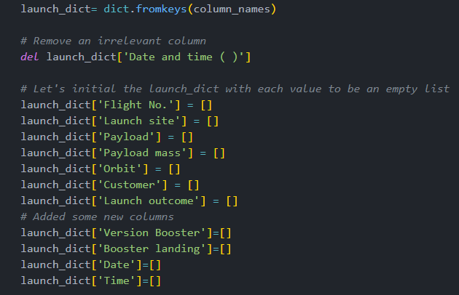
DATA COLLECTION – WEB SCRAPING
1
Web scraping to collect Falcon 9 historical launch records from a Wikipedia page titled List of Falcon 9 and Falcon Heavy launches.
2
Request the HTML page from the static URL , Assign the response to an object
Create a BeautifulSoup object from the HTML response object , Find all tables within the HTML page
Collect all column header names from the tables found within the HTML page
Use the column names as keys in a dictionary, Use custom functions and logic to parse all launch tables (see Appendix) to fill the dictionary values
3
4

Slide 9
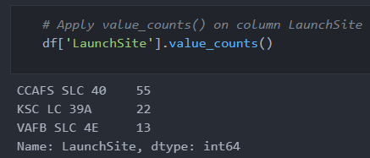
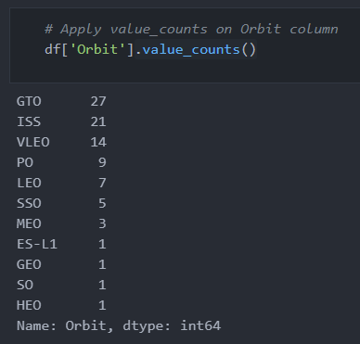
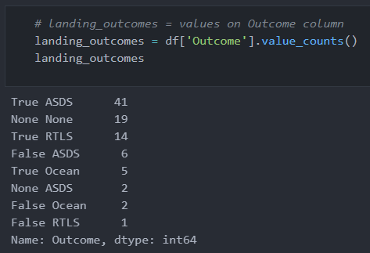
DATA MANIPULATION/WRANGLING – PANDAS
1
CONTEXT:
The SpaceX dataset contains several Space X launch facilities, and each location is in the LaunchSite column.
Each launch aims to a dedicated orbit, and some of the common orbit types are shown in the figure below. The orbit type is in the Orbit column.
INITIAL DATA EXPLORATION:
Using the .value_counts() method to determine the following:
Number of launches on each site
Number and occurrence of each orbit
Number and occurrence of landing outcome per orbit type
2
3

Slide 10
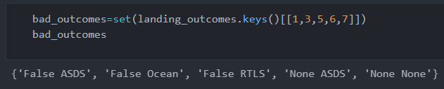
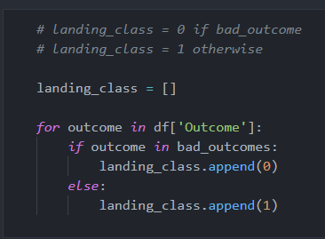

DATA MANIPULATION/WRANGLING – PANDAS
1
Context:
The landing outcome is shown in the Outcome column:
True Ocean – the mission outcome was successfully landed to a specific region of the ocean
False Ocean – the mission outcome was unsuccessfully landed to a specific region of the ocean.
True RTLS – the mission outcome was successfully landed to a ground pad
False RTLS – the mission outcome was unsuccessfully landed to a ground pad.
True ASDS – the mission outcome was successfully landed to a drone ship
False ASDS – the mission outcome was unsuccessfully landed to a drone ship.
None ASDS and None None – these represent a failure to land.
Data Wrangling:
Defining a set of unsuccessful (bad) outcomes, bad_outcome
Creating a list, landing_class, where the element is 0 if the corresponding row in Outcome is in the set bad_outcome, otherwise, it’s 1.
Create a Class column that contains the values from the list landing_class
Export the DataFrame as a .csv file.
2
3
4

Slide 11
Exploratory data analysis (eda) – visualization
SCATTER CHARTS
BAR CHART
LINE CHARTS
Scatter charts are useful to observe relationships, or correlations, between two numeric variables.
Bar charts are used to compare a numerical value to a categorical variable. Horizontal or vertical bar charts can be used, depending on the size of the data.
Line charts contain numerical values on both axes, and are generally used to show the change of a variable over time.

Slide 12
Exploratory data analysis (eda) – sql
To gather some information about the dataset, some SQL queries were performed.
The SQL queries performed on the data set were used to:
Display the names of the unique launch sites in the space mission
Display 5 records where launch sites begin with the string ‘CCA’
Display the total payload mass carried by boosters launched by NASA (CRS)
Display the average payload mass carried by booster version F9 v1.1
List the date when the first successful landing outcome on a ground pad was achieved
List the names of the boosters which had success on a drone ship and a payload mass between 4000 and 6000 kg
List the total number of successful and failed mission outcomes
List the names of the booster versions which have carried the maximum payload mass
List the failed landing outcomes on drone ships, their booster versions, and launch site names for 2015
Rank the count of landing outcomes (such as Failure (drone ship) or Success (ground pad)) between the date 2010-06-04 and 2017-03-20, in descending order

Slide 13
Predictive Analysis - Classification
The following steps were taking to develop, evaluate, and find the best performing classification model:
Model Development
Model Evaluation
To prepare the dataset for model development:
Load dataset
Perform necessary data transformations (standardise and pre-process)
Split data into training and test data sets, using train_test_split()
Decide which type of machine learning algorithms are most appropriate
For each chosen algorithm:
Create a GridSearchCV object and a dictionary of parameters
Fit the object to the parameters
Use the training data set to train the model
Finding the Best Classification Model
For each chosen algorithm:
Using the output GridSearchCV object:
Check the tuned hyperparameters (best_params_)
Check the accuracy (score and best_score_)
Plot and examine the Confusion Matrix
Review the accuracy scores for all chosen algorithms
The model with the highest accuracy score is determined as the best performing model

Slide 14
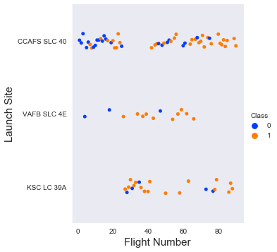
RESULTS :
EDA - WITH VISUALIZATION
Launch Site VS. FLIGHT NUMBER
The scatter plot of Launch Site vs. Flight Number shows that:
As the number of flights increases, the rate of success at a launch site increases.
Most of the early flights (flight numbers < 30) were launched from CCAFS SLC 40, and were generally unsuccessful.
The flights from VAFB SLC 4E also show this trend, that earlier flights were less successful.
No early flights were launched from KSC LC 39A, so the launches from this site are more successful.
Above a flight number of around 30, there are significantly more successful landings (Class = 1).

Slide 15
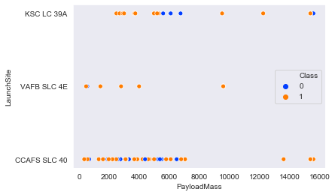
RESULTS : EDA - WITH VISUALIZATION
LAUNCH SITE vs. PAYLOAD MASS
The scatter plot of Launch Site vs. Payload Mass shows that:
Above a payload mass of around 7000 kg, there are very few unsuccessful landings, but there is also far less data for these heavier launches.
There is no clear correlation between payload mass and success rate for a given launch site.
All sites launched a variety of payload masses, with most of the launches from CCAFS SLC 40 being comparatively lighter payloads (with some outliers).

Slide 16
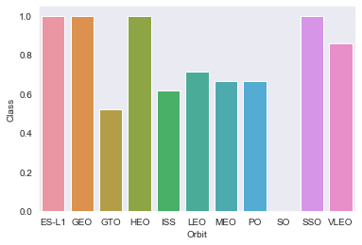
RESULTS : EDA - WITH VISUALIZATION
RESULTS : EDA - WITH VISUALIZATION
Success Rate vs. Orbit Type
The bar chart of Success Rate vs. Orbit Type shows that the following orbits have the highest (100%) success rate:
ES-L1 (Earth-Sun First Lagrangian Point)
GEO (Geostationary Orbit)
HEO (High Earth Orbit)
SSO (Sun-synchronous Orbit)
The orbit with the lowest (0%) success rate is:
SO (Heliocentric Orbit)

Slide 17
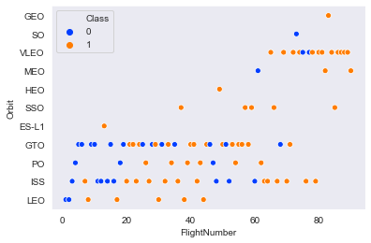
RESULTS : EDA - WITH VISUALIZATION
Orbit Type vs. flight number
This scatter plot of Orbit Type vs. Flight number shows a few useful things that the previous plots did not, such as:
The 100% success rate of GEO, HEO, and ES-L1 orbits can be explained by only having 1 flight into the respective orbits.
The 100% success rate in SSO is more impressive, with 5 successful flights.
There is little relationship between Flight Number and Success Rate for GTO.
Generally, as Flight Number increases, the success rate increases. This is most extreme for LEO, where unsuccessful landings only occurred for the low flight numbers (early launches).

Slide 18
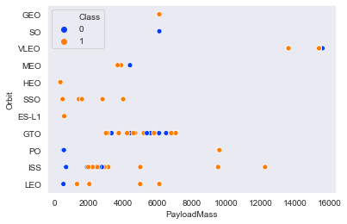
RESULTS : EDA - WITH VISUALIZATION
ORBIT TYPE VS. PAYLOAD MASS
This scatter plot of Orbit Type vs. Payload Mass shows that:
The following orbit types have more success with heavy payloads:
PO (although the number of data points is small)
ISS
LEO
For GTO, the relationship between payload mass and success rate is unclear.
VLEO (Very Low Earth Orbit) launches are associated with heavier payloads, which makes intuitive sense.

Slide 19
RESULTS : EDA - WITH VISUALIZATION
ORBIT TYPE VS. PAYLOAD MASS
This scatter plot of Orbit Type vs. Payload Mass shows that:
The following orbit types have more success with heavy payloads:
PO (although the number of data points is small)
ISS
LEO
For GTO, the relationship between payload mass and success rate is unclear.
VLEO (Very Low Earth Orbit) launches are associated with heavier payloads, which makes intuitive sense.

Slide 20
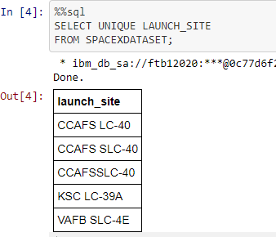
RESULTS : EDA- WITH SQL
All Launch Sites Names
Query unique launch site names from database.
CCAFS SLC-40 and CCAFSSLC-40 likely all represent the same
launch site with data entry errors.
CCAFS LC-40 was the previous name. Likely only 3 unique launch_site values: CCAFS SLC-40, KSC LC-39A, VAFB SLC-4E

Slide 21
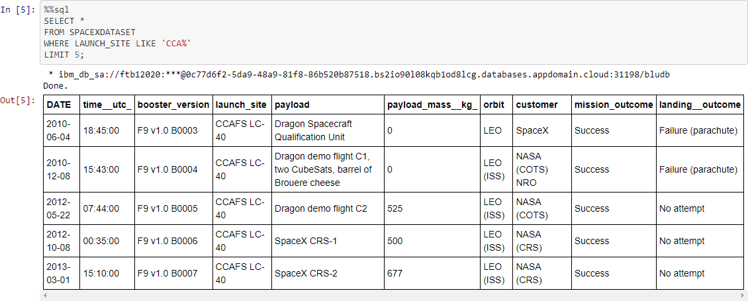
RESULTS : EDA- WITH SQL
Launch Site Names Beginning with `CCA`

Slide 22
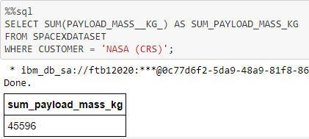
RESULTS : EDA- WITH SQL
Total Payload Mass from NASA
This query sums the total payload mass in kg where NASA was the customer.

Slide 23
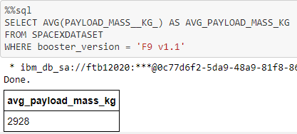
RESULTS : EDA- WITH SQL
Average Payload Mass by F9 v1.1
This query calculates the average payload mass or launches which used booster version F9 v1.1

Slide 24
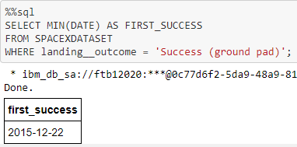
RESULTS : EDA- WITH SQL
First Successful Ground Pad Landing Date
This query returns the first successful ground pad landing date.
First ground pad landing wasn’t
until the end of 2015.

Slide 25
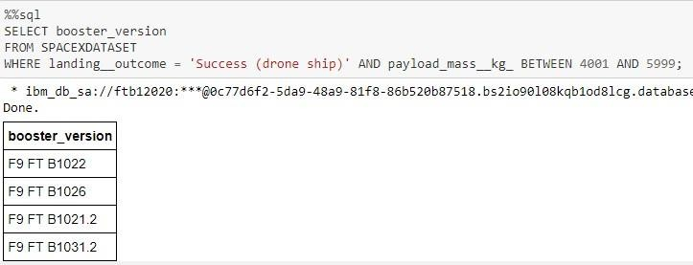
RESULTS : EDA- WITH SQL
Successful Drone Ship Landing with Payload Between 4000 and 6000
This query returns the four booster versions that had successful drone ship landings and a payload mass between 4000 and 6000 noninclusively.

Slide 26
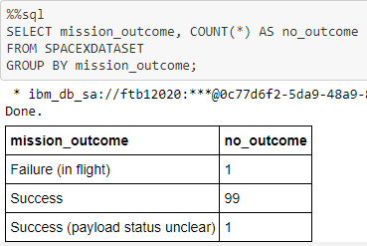
RESULTS : EDA- WITH SQL
Total Number of Each Mission Outcome
SpaceX appears to achieve its mission outcome nearly 99% of the time.
This means that most of the landing
failures are intended.
Interestingly, one launch has an unclear payload status and unfortunately one failed in flight.

Slide 27
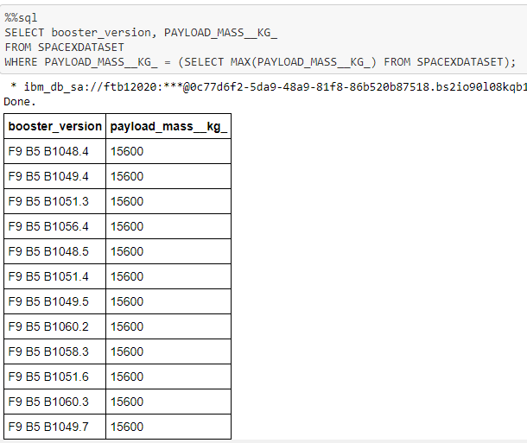
RESULTS : EDA- WITH SQL
Boosters that Carried Maximum Payload
This query returns the booster versions that carried the highest payload mass of 15600 kg.
This likely indicates payload mass correlates with the booster version that is used.

Slide 28
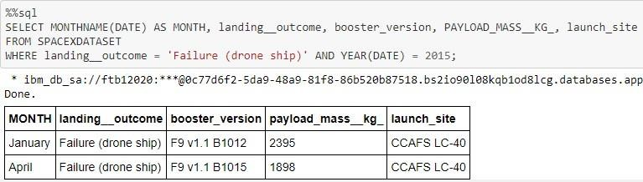
RESULTS : EDA- WITH SQL
2015 Failed Drone Ship Landing Records
This query returns the Month, Landing Outcome, Booster Version, Payload Mass (kg), and Launch site of 2015 launches where stage 1 failed to land on a drone ship.
There were two such occurrences.

Slide 29
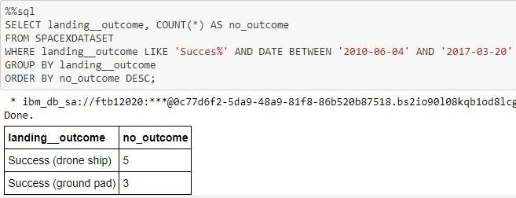
RESULTS : EDA- WITH SQL
Ranking Counts of Successful Landings Between 2010-06-04 and 2017-03-20
This query returns a list of successful landings and between 2010-06-04 and 2017-03-20 inclusively.
There were 8 successful landings in total during this time period

Slide 30
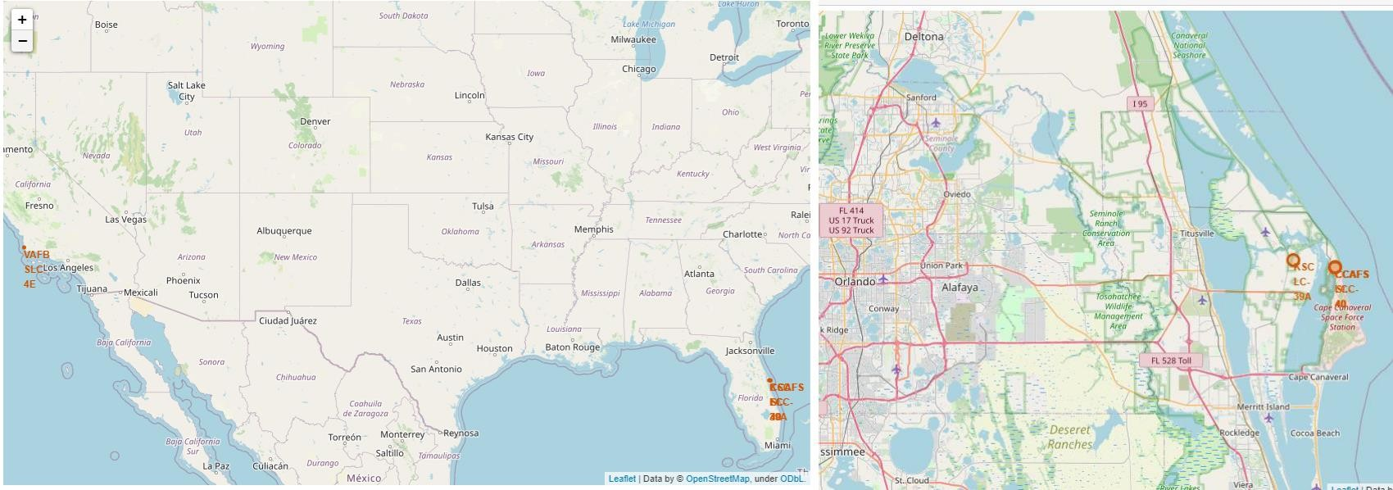
RESULTS : Interactive Map with Folium
Launch Site Locations
The left map shows all launch sites relative US map. The right map shows the two Florida launch sites since they are very close to each other..

Slide 31
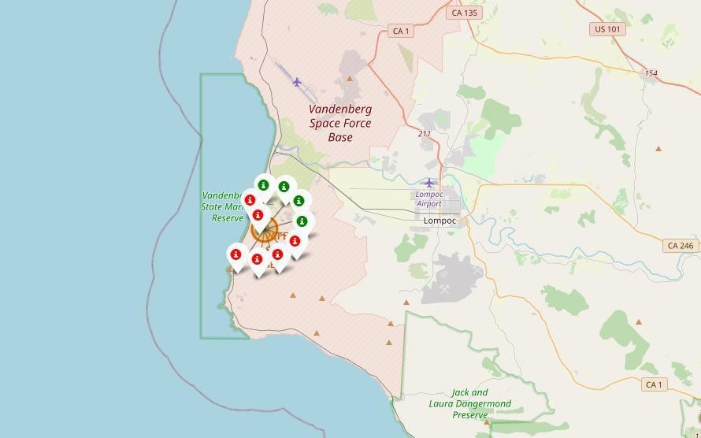
RESULTS : Interactive Map with Folium
Color-Coded Launch Markers
Clusters on Folium map can be clicked on to display each successful landing (green icon) and failed landing (red icon). In this example VAFB SLC-4E shows 4 successful landings and 6 failed landings.

Slide 32
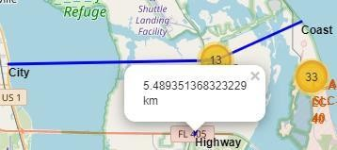
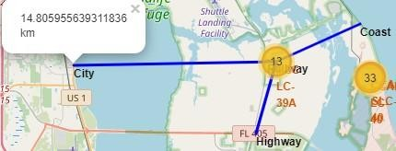
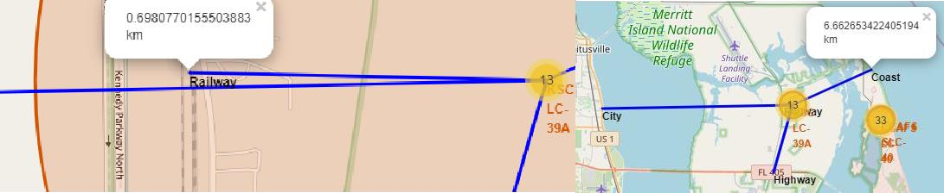
RESULTS : Interactive Map with Folium
Key Location Proximities
KSC LC-39A launch sites are strategically located near railways, highways, coasts, and cities to minimize launch failures and ensure safe landings in densely populated areas.

Slide 33
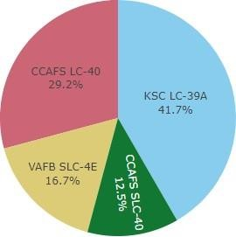

RESULTS : Build a Dashboard with Plotly Dash
Successful Launches Across Launch Sites
Successful landings at CCAFS LC-40 and KSC are similar, with most performed before name change. VAFB has the smallest share due to smaller sample and west coast launch difficulty.

Slide 34
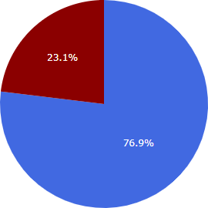

RESULTS : Interactive Map with Folium
Highest Success Rate Launch Site
KSC LC-39A has the highest success rate with 10 successful landings and 3 failed landings.

Slide 35
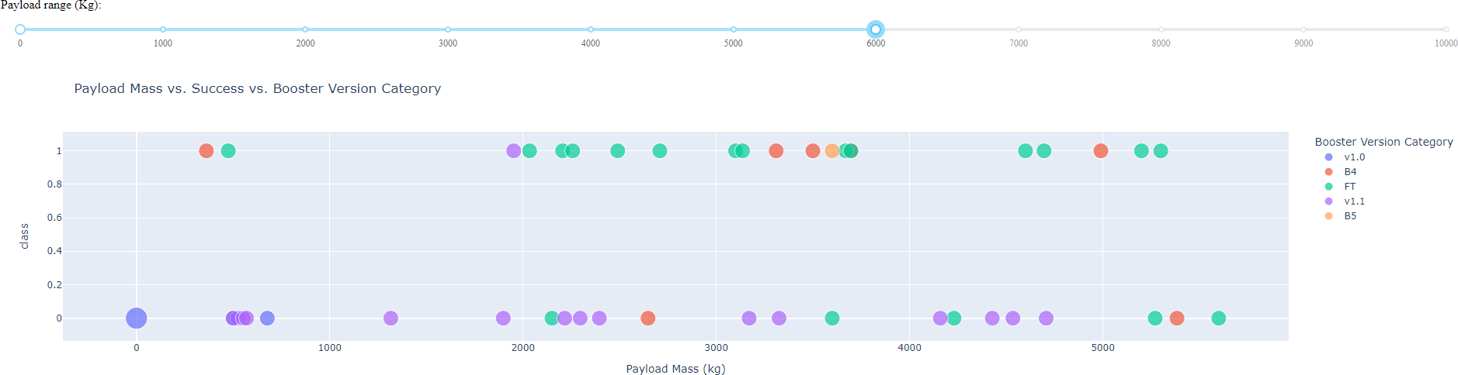
RESULTS : Interactive Map with Folium
Payload Mass vs. Success vs. Booster Version Category
The Plotly dashboard's payload range selector is set from 0-10000, with two failed landings with zero kg payloads in the 0-6000 range, indicating a booster version category.

Slide 36
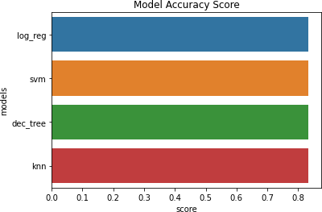
RESULTS : Predictive Analysis(Classification)
GRIDSEARCHCV(CV=10) ON LOGISTIC REGRESSION, SVM, DECISION
TREE, AND KNN
Classification Accuracy
All models had virtually the same accuracy on the test set at 83.33% accuracy. This can cause large variance in accuracy results, such as those in Decision Tree Classifier model in repeated runs.We likely need more data to determine the best model.

Slide 37
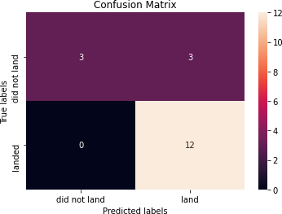
RESULTS : Predictive Analysis(Classification)
GRIDSEARCHCV(CV=10) ON LOGISTIC REGRESSION, SVM, DECISION
TREE, AND KNN
Confusion Matrix
Correct predictions are on a diagonal from top left to bottom right.

Slide 38
CONCLUSION
Our task is to develop a machine learning model for Space Y who wants to bid against SpaceX.
The goal of model is to predict when Stage 1 will successfully land to save ~$100 million USD.
Used data from a public SpaceX API and web scraping SpaceX Wikipedia page.
Created data labels and stored data into a DB2 SQL database.
Created a dashboard for visualization purpose.
We created a machine learning model with an accuracy of 83%.
If possible more data should be collected to better determine the best machine learning model and improve accuracy.
SpaceX's Ellon Mask uses a model to predict successful Stage 1 landings for launches, ensuring high accuracy in determining launch feasibility.

Slide 39
APPENDIX
GitHub repository : https://github.com/kac-1120/IBM_DATA_SCIENCE_PROFESSIONAL
Instructors:
Rav Ahuja, Alex Aklson, Aije Egwaikhide, Svetlana Levitan, Romeo Kienzler, Polong Lin, Joseph Santarcangelo, Azim Hirjani, Hima Vasudevan, Saishruthi Swaminathan, Saeed Aghabozorgi, Yan Luo

